Slide 1

Generating Domain-Specific Paraphrases of Questions from FAQ
By: Ng Jing Rui
Supervisor: Prof Chng Eng Siong
SCSE20-0063
Notes:
Good afternoon Prof Chng and Prof Li, my name is Jing Rui.
Today I will be presenting my FYP project that I have worked on under the guidance of my FYP supervisor, Prof Chng Eng Siong and his team.

Slide 2
Outline
Background Information
(Slide 3 – 7)
Literature Review
(Slide 8 – 11)
Proposed Solution’s System Architecture
(Slide 12 – 23)
Results
(Slide 24)
Conclusion
(Slide 25)
Future Works
(Slide 26)
Outline
Notes:
I will be going through these six main components shown on the screen with their respective slide numbers specified below for your easy reference.

Slide 3








FAQ Retrieval System
Browse through
FAQs of
User A
Website
Set up by
FAQ Retrieval
a. Send query to
Businesses
c. Answer user
query
User B
FAQ Chatbot
b. Retrieve most relevant answer
Better User Experience
FAQ Webpages
Background Information – Importance of FAQ Retrieval System
Notes:
Now what is a FAQ Retrieval System?
Businesses typically set up a website for their users. When a user need some information, they typically go through the FAQs of the website, just like user A [CLICK] .
However, Businesses can also set up chatbot that will help user to navigate their FAQ webpages [CLICK] Now, users can engage the chatbot like user B [[CLICK] ] by sending a query to the chatbot, and the chatbot will retrieve the most relevant answer from the FAQ webpages to answer the user query. Therefore, what is encapsulated in this blue box [[CLICK] ] is the FAQ retrieval system.
[CLICK] FAQ retrieval system can give users a better user experience that ultimately benefits the businesses in many ways.

Slide 4
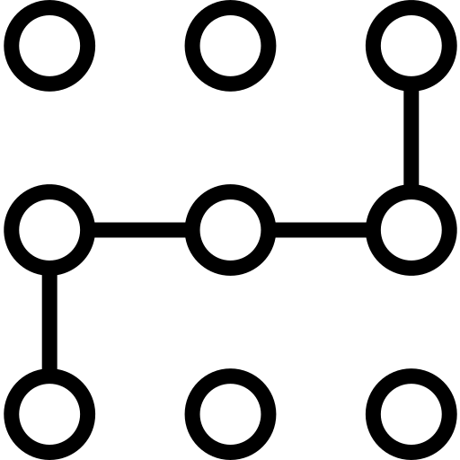
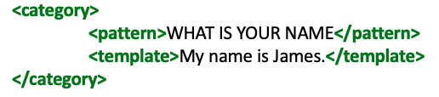
Traditional Approach
Pattern Matching via Artificial Intelligence Markup Language (AIML)
Manual definition of patterns
Expensive labour costs to define accurate patterns
Background Information – Traditional Approach of FAQ Retrieval System
Notes:
To set up FAQ retrieval system, Artificial Intelligence Markup language (AIML) can be used [CLICK], by defining patterns similar to the one shown on the right side. The system will answer the query by performing pattern matching.
[CLICK] However, this approach requires a lot of manual work and labour costs to define accurate patterns.

Slide 5





Modern Approach
Neural Network Model
e.g. BERT
1.
Similarity Evaluation via Deep Neural Network Model
4.05/5
User
User Query
2.
4.83/5
Automatic Similarity
Evaluation
MAX similarity score = 4.83
Cost-Savings
...
Insufficient FAQ pairs for model training
n.
Data Augmentation needed!
3.62/5
Background Information – Modern Approach of FAQ Retrieval System
Notes:
A modern approach would be to use Deep Neural Network model. Suppose that the user submit a query [click], and there are n number of FAQ pairs [click], this approach will use a neural network model such as BERT to [click] evaluate the similarity between the query and the first Q&A pair and continues until it reaches the last Q&A pair. Finally, the Q&A pair with the maximum similarity score is answer the user’s query.
This is also how the team at NTU Speech Lab has set up their chatbot based on the FAQs of the Ministry of Social and Family Development, or in short MSF. As a result, the chatbot can be set-up automatically in an end-to-end manner using only the FAQ dataset.
[CLICK] While this approach is effective and provides cost savings, there are often insufficient FAQ pairs for model training, [CLICK], therefore we need to perform data augmentation, which is the focus of this project.

Slide 6
Data Augmentation
Paraphrase this!
Question
Answer
How can I save in the Child Development Account (CDA)?
You can save in the Child Development Account (CDA) by depositing cash, cheque or Standing Order.
What are some ways to save in Child Development Account (CDA)?
You can save in the Child Development Account (CDA) by depositing cash, cheque or Standing Order.
What should I do to save in Child Development Account (CDA)?
You can save in the Child Development Account (CDA) by depositing cash, cheque or Standing Order.
...
...
Repeat this process manually until you have k paraphrases of the question for each FAQ pairs, for all n FAQ pairs
& paraphrases should be semantically similar to the original, while retaining its syntax integrity.
Becomes increasingly manual intensive and expensive by a factor of k for every increment of FAQ pair!
Resulting paraphrases are high-quality, reliable and specific to the domain of the FAQ itself.
Background Information – Data Augmentation
Notes:
Now, suppose we have the question and answer shown on the screen and we want to perform the Data Augmentation manually. For every FAQ pair, you will [CLICK] generate paraphrase of the question while retaining the same answer.
[CLICK]. You may then come out with these paraphrases. However, you will have to repeat this process n times for n FAQ pairs and for each FAQ pair, you are generating k paraphrases of its question field.
[CLICK] This implies that this process becomes increasingly manual intensive and expensive by a factor of k for every new FAQ pair that you get.
While this way of data augmentation can be manual intensive and costly, [CLICK] it is undeniable that the paraphrases generated by the relevant domain experts are likely to be high-quality, reliable and specific to the domain of the FAQ itself. In this project, we view paraphrases to be domain-specific if the paraphrases retained domain terms that are abbreviated, such as “Child Development Account (CDA)”.

Slide 7

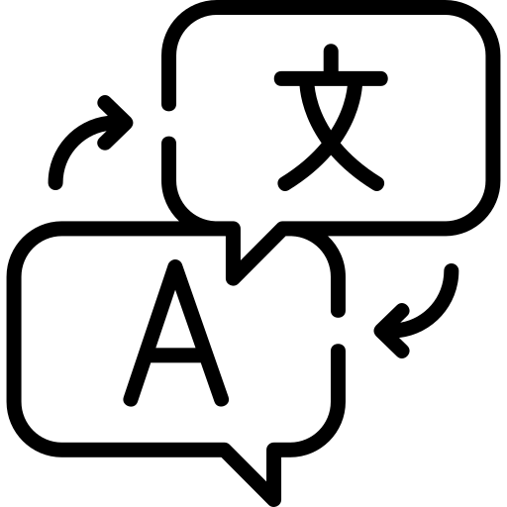

Data Augmentation
Paraphrase Generation
Back Translation
Word Replacement
Pre-trained Language Models
Generate high-quality and domain-specific parallel data autonomously
Savings on domain expertise for manual generation of paraphrases
Complement automatic and end-to-end set-up process of FAQ retrieval system that uses neural network model for similarity evaluation
Background Information – Existing Issues & Motivation
Notes:
As the chatbot of NTU speech lab based on similarity evaluation was set up in an end-to-end and automatic manner, it was not an option to perform data augmentation manually, as doing so would introduce a manual element into an otherwise automatic process. Therefore, past FYP students have worked extensively on the task of paraphrase generation to perform automatic data augmentation, specifically through back-translation or word replacement. However, the paraphrases resulting from these two approaches have some known issues. I will illustrate these issues with concrete examples in the later literature review.
Therefore, in this project, we hope to tackled the task of data augmentation [CLICK] by using pre-trained language models, so that we can generate high-quality and domain-specific parallel data autonomously. Effective augmentation of the FAQ dataset translates to savings on the cost of domain-expertise to manually generate paraphrases and complements the end-to-end set-up process of FAQ retrieval system that uses neural network model to perform similarity evaluation.

Slide 8
Paraphrase Generation
Paraphrase Generation
Back Translation
Word Replacement
Pre-trained Language Models
Contextualized Word Embeddings
Neural
Network
Pre-trained Word Embeddings
Easy Data Augmentation
Timeline
Statistical
Timeline
Unsupervised
Supervised
Thesaurus
Literature Review – Paraphrase Generation
Notes:
There are three main ways of performing paraphrase generation.
The first way is the back translation, [CLICK] which can be achieved using statistics or neural network with neural network being more recently introduced as indicated by the blue timeline arrow.
The second way is the word replacement, [CLICK] which can be tackled using various means as shown. Each of the listed means are described in greater details in my FYP report, but in my presentation, I will explain the gist of these two approaches using examples.
[CLICK] The third way is using pre-trained language models, which can be approached using unsupervised or supervised learning. This is one of the latest way in NLP to tackle paraphrase generation.

Slide 9


Back Translation
Source Language: English
Pivot Language: Thai
How can I save in the Child Development Account?
Original
Back Translation
ฉันจะบันทึกในบัญชีพัฒนาการเด็กได้อย่างไร
Effective way of Data Augmentation
Intermediate Output
Paraphrases found to be domain irrelevant at times as the same word can be expressed differently in different domains
How do I record it in my Child Development account?
Paraphrase
Literature Review – Back Translation
Note: Demo results from Google Translate
Notes:
The gist of back translation involves [CLICK] translating the original sentence from the source language to the pivot language [CLICK] and back to the source language.
As I do not have an existing back-translation system to produce the results, I have performed the translation using Google Translate to obtain the results shown on screen.
[CLICK] Back translation can be an effective way of data augmentation, but it fails to generate domain-specific paraphrases as the same word can be expressed differently in different domains.

Slide 10
Word Replacement
DistilBERT
RoBERTA
BERT
XLNet
Contextualized Word Embeddings
How can I save in the Child Development Account (CDA)?
nlpAug
Word Replacement
Original
Python Library
Simple Data Augmentation
“Insert” Operation
“Substitute” Operation
May replace words of domain-specific terms such as ”Child Development Account (CDA)”
how can do i even save money in the child development account ( or cda ) ?
how will you save in the personal credit account ( cda )?
Paraphrase 2 (Substitute)
Paraphrases may turn out semantically or grammatically incorrect
Paraphrase 1 (Insert)
Literature Review – Word Replacement
Note: Demo results from nlpAug use of ‘bert-base-uncased’
Notes:
One way to perform word replacement is to use contextualized word embeddings that takes into account the words surrounding the target word. Such use is implemented in a python library nlpAug. [CLICK] If we perform the insert operation on the original sentence, we may get paraphrase 1. [CLICK] If we perform the substitute operation on the same original sentence, we may get paraphrase 2. [CLICK] From these two examples, we can observe that words of domain-specific terms can end up being replaced as shown in Paraphrase 2 and paraphrases may also turns out grammatically unsound as shown in Paraphrase 1.

Slide 11


Pre-trained Language Models
Candidate
Selection
Generation
Language Models
Original
Generated
Paraphrases
Candidate
Paraphrases
Pre-trained Language Models
Supervised
Unsupervised
Performs badly in generating domain-specific paraphrases
Focused on generating domain-specific paraphrases
Focused on generating paraphrases of sentences instead of questions
Filtering based solely on semantic similarity between original and paraphrase is insufficient
Literature Review – Pre-trained Language Model
Note: Pros and Cons specific to two recent works described in FYP report
Notes:
Language models works like a black box whereby [CLICK] we pass in the input question, and [CLICK] get the paraphrases as the output. As paraphrase generation is random by nature, [CLICK] it is necessary to perform candidate selection to retain high-quality paraphrases. In my FYP report, I have described [CLICK] two recent works that tackled paraphrase generation in a supervised and unsupervised setting, respectively.
Our project closely relates to the work based on supervised learning but [CLICK] improves on it by focusing on generating domain-specific paraphrases and generating paraphrases of questions instead of sentences. Our project also extends the work based on unsupervised learning [CLICK] specifically in their candidate selection process where paraphrases are filtered based solely on their semantic similarity with the original, which is not enough.

Slide 12
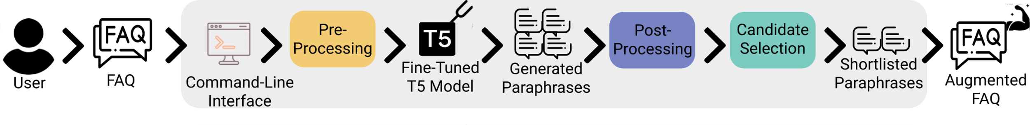
System Architecture
Paraphrase Generation System
Objectives
To fine-tune T5 model on the task of Paraphrase Generation using off-domain labelled paraphrase dataset
To generate domain-specific paraphrases of questions
To shortlist eligible candidate paraphrases
To provide a command-line interface for users to perform the generation
System Architecture
Notes:
This is the System architecture that I have designed and implemented in this FYP, and [CLICK] with the following objectives. [CLICK] I will explain the components of the implemented system in the subsequent slides.

Slide 13




Fine-tuned T5 Model
+
=
Quora Question Pairs
Clean T5 Model
Fine-Tuned T5 Model
Labelled paraphrase dataset
Released by Quora in 2017
Out of ~400k question pairs, 140k are paraphrases
Dynamically downloaded from Google Drive if user does not have the model saved locally
System Architecture – Fine-tuned T5 Model
Notes:
To prepare the neural model for the task of paraphrase generation, we downloaded a clean T5 model and fine-tuned the T5 model on a labelled paraphrase dataset released by Quora in 2017. This dataset gives us around 140k paraphrase pairs. Among all the labelled paraphrase dataset available online, I chose Quora Question Pair as my training dataset primarily because it contain paraphrases of questions, and not sentences.
As the size of this fine-tuned T5 model was too large to be uploaded to my GitHub repository, [CLICK] I have implemented a feature where the system will automatically download the model from my Google Drive into the user’s local drive. This feature activates automatically when the user first use the system and does not have my model saved locally.

Slide 14
Hyperparameters
Hyperparameter Name | Value
Max Sequence Length | 512
Learning Rate | 3e-4
Weight Decay | 0.0
Adam Epsilon | 1e-8
Warmup Steps | 0
Train Batch Size | 6
Evaluation Batch Size | 6
Number of Epochs | 2
Hyperparameter Name | Value
Gradient Accumulation Steps | 16
Number of GPU | 1
Early Stop Callback | False
FP_16 | False
Opt Level | 01
Maximum Gradient Norm | 1.0
Seed | 42
System Architecture – Fine-tuned T5 Model (Hyperparameters)
Notes:
In the fine-tuning process of the T5 model, we experimented with various values of the hyperparameters, and finally settled upon the following values for the hyper-parameters shown on the screen.

Slide 15
Generation Configuration
How can I save in the Child Development Account (CDA)?
Original
40 x
Fine-Tuned T5 Model
Paraphrase
Argument Name | Default Value
top_k | 120
top_p | 0.98
max_len | 256
num_return | 40
Generation Arguments
System Architecture – Fine-tuned T5 Model (Generation Configuration)
Notes:
After we have the fine-tuned T5 model, we are ready to pass in each of the FAQ questions one at a time to the model for paraphrase generation. Alongside with the FAQ question, we also need to pass in [CLICK] the generation arguments. I had set the following default values of the generation arguments. I find that these argument values gives me the most consistent results when I repeatedly performed data augmentation with my model. As the argument “num_return” was set to 40 [CLICK], the T5 model will generate 40 paraphrases of the given original question. However, we may not want to keep all 40 paraphrases as they are unlikely to be equally good, given the random nature of the generation. This makes the later candidate selection process necessary. Furthermore, we may also observe that domain-specific terms may still end up getting replaced during the generation, which goes against the objective of our project. This leads us to our next slide on pre and post-processing.

Slide 16
Pre- and Post- Processing
Pre-Processing
Post-Processing
How can I save in the Child Development Account (CDA)?
What are some ways to save in CDA?
Original
Paraphrase
{“CDA”: “Child Development Account”}
How can I save in the CDA?
What are some ways to save in Child Development Account (CDA)?
Original
Paraphrase
This form of processing is a novelty feature that helped us to ensure that domain-specific terms are retained without any parts being replaced by synonyms, while helping our model to generate paraphrases of all FAQ questions successfully.
System Architecture – Pre and Post Processing
Notes:
To perform the pre-processing of the original question, we [CLICK] extracted the abbreviation “CDA” and its expansion “Child Development Account” and [CLICK] retained only the abbreviation “CDA”.
Post-processing is then performed on the paraphrase by reinstating the abbreviation and its expansion.
[CLICK] This form of processing is a novelty feature that helped us to ensure that domain-specific terms are retained without any parts being replaced by synonyms, while helping our model to generate paraphrases of all FAQ questions successfully.

Slide 17
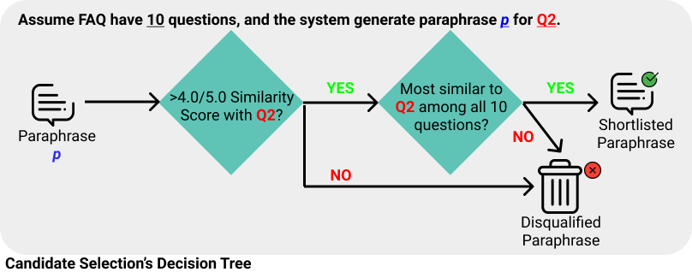
Candidate Selection
Step 1
Step 2
Step 1 with threshold similarity score of 4.0 ensure that paraphrases are semantically similar to their original, while being slightly different from the original question.
System Architecture – Candidate Selection
Notes:
After we performed post-processing of the generated paraphrases, we decide which paraphrase to retain using the decision tree shown on the screen. This candidate selection process consists of [CLICK] step 1 and step 2. I will start with explaining step 1. [CLICK]
In step 1, we accept paraphrase p if it has a similarity score of at least 4.0 when compared to its original question Q2. The threshold similarity score of 4.0 was chosen so that we ensure that paraphrases are semantically similar to their original question, while being slightly different from the original question. We will now look at a demonstration of step 1.

Slide 18


Step 1
Similarity Score
Between
Original and Paraphrase
Fine-Tuned
T5
Original
Paraphrases
How can I save in the Child Development Account (CDA)?
SBERT
Can I save to the Child Development Account (CDA)?
4.79
> 4.0?
How much can I save in the Child Development Account (CDA)?
What is the best way to save in Child Development Account (CDA)?
4.77
> 4.0?
How can we save money in the Child Development Account (CDA)?
4.61
Where can I use the Child Development Account (CDA) funds?
> 4.0?
I have a Child Development Account (CDA). How do I save it?
4.29
> 4.0?
…
I just finished doing Child Development Account (CDA) application?
3.19
> 4.0?
System Architecture – Candidate Selection Step 1 (Demo)
Notes:
For the demonstration of step 1, we use three original questions from the FAQ, where the first one is used [CLICK] to generate paraphrases with my fine-tuned T5 model. [CLICK].These are the paraphrases generated by the T5 model. We will then [CLICK] load a clean SBERT model to [CLICK] determine the score between the original and its paraphrase. We will then carry out the step 1, by checking whether the similarity score is above 4.0. Paraphrase above 4.0 are accepted, while [CLICK] paraphrase below 4.0 are rejected.

Slide 19
Candidate Selection
Step 1
Step 2
Step 2 is the novelty feature of the candidate selection process.
System Architecture – Candidate Selection
Notes:
The paraphrases accepted in step 1 [CLICK] are passed to the step 2.[CLICK] Step 2 is a novelty feature that I have incorporated into my candidate selection process to check whether paraphrase p is the most similar to its original question Q2, as compared to other questions in the FAQ dataset.

Slide 20
Similar FAQ Questions
Step 2 is the novelty feature of the candidate selection process.
Class Label | Question 1 : Question 2 | Score
1 | “How much can I save in the Child Development Account (CDA)?" -----> Answer 1 “How can I save in the Child Development Account (CDA)?" -----> Answer 2 | 4.80
2 | top_p | 0.98
…
This observation explains why some paraphrases of question 2 can turn out most similar to question 1 and hence are rejected in step 2.
System Architecture – Candidate Selection Step 2 (Inspiration)
Notes:
The primary inspiration for step 2 was because I observed that in a FAQ dataset, there are some very similar FAQ questions that are mapped to different answer. For example, the question with class label 1 and the question with class label 2 are mapped to answer 1 and 2 respectively. But when we compute the similarity score between the two questions, we obtain a very high similarity score of 4.80. More examples of similar FAQ pairs are provided in my FYP report. [CLICK] This observation explains why some paraphrases of question 2 turns out to be most similar to question 1 and hence are rejected in step 2. We will now look at the demonstration of step 2.

Slide 21
Step 2 (Paraphrase 1)
1
How can I save in the Child Development Account (CDA)?
From
How much can I save in the Child Development Account (CDA)? (Score: 4.76)
Original
FAQ Dataset
2
How can I save in the Child Development Account (CDA)? (Score: 4.73)
As Knowledge
Source
3
When can I start saving in the Child Development Account (CDA)? (Score: 4.50)
How can we save money in the Child Development Account (CDA)?
4
Where can I use the Child Development Account (CDA) funds? (Score: 4.43)
Paraphrase 1 (Score: 4.61)
As Query
5
SBERT
How can I make payment using my Child Development Account (CDA) funds? (Score: 4.33)
I have a Child Development Account (CDA). How do I save it?
Therefore, position of original in top-5 most similar question = 2
Paraphrase 2 (Score: 4.29)
Position = 1?
System Architecture – Candidate Selection Step 2 (Demo)
Notes:
For the demonstration of step 2, I will use paraphrase 1 and 2 as an example, and both paraphrase are generated from the original question shown above. This original question [CLICK] is from the FAQ dataset. [CLICK] Now using the same SBERT model from step 1, we submit [CLICK] paraphrase 1 as a query and the FAQ dataset as a knowledge source to [CLICK] to find the top 5 most similar questions from the FAQ dataset. As you can see, in this case, the position of the original question is [CLICK] second place, therefore position is 2. [CLICK] As the position is not 1, paraphrase 1 is rejected as it is not the most similar to its original.

Slide 22
Step 2 (Paraphrase 2)
1
How can I save in the Child Development Account (CDA)?
From
How can I save in the Child Development Account (CDA)? (Score: 4.68)
Original
FAQ Dataset
2
How much can I save in the Child Development Account (CDA)? (Score: 4.49)
As Knowledge
Source
3
When can I start saving in the Child Development Account (CDA)? (Score: 4.33)
How can we save money in the Child Development Account (CDA)?
4
Where can I use the Child Development Account (CDA) funds? (Score: 4.12)
Paraphrase 1 (Score: 4.61, Position: 2)
As Query
5
SBERT
How can I change my Child Development Account (CDA) bank? (Score: 4.05)
I have a Child Development Account (CDA). How do I save it?
Therefore, position of original in top-5 most similar question = 1
Paraphrase 2 (Score: 4.29)
Position = 1?
System Architecture – Candidate Selection Step 2 (Demo)
Notes:
This process is [CLICK] repeated for paraphrase 2. As the original question is [CLICK] now in first place, position is 1. Paraphrase 2, is therefore accepted. The step 2 of candidate selection is crucial in shortlisting eligible candidate paraphrase as [CLICK] you may have observed by now that even though paraphrase 1 with score of 4.61 is more similar to the original than paraphrase 2, paraphrase 1 is not eligible as it is more similar to other questions of the FAQ, instead of its original.

Slide 23
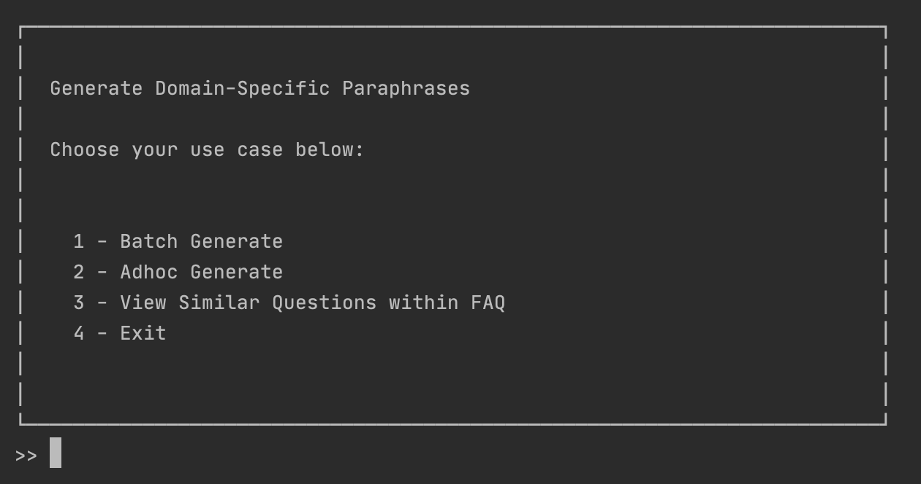
Command-Line Interface
User can specify location of FAQ corpus to be augmented
User can decide how many n paraphrase to generate for each question, and to retain the top k paraphrases.
System Architecture – Command-Line Interface
Notes:
I have implemented the command-line interface shown on the screen so that user can use this interface to perform data augmentation of their FAQ corpus by specifying its location. I also allow users to decide how many n paraphrase to generate for each question with the default being 40, and to retain the top k paraphrase during the candidate selection. If the user decided the k value to be 5, then the size of the FAQ dataset will increase by around 5 times.

Slide 24
Results
How can I save in the Child Development Account (CDA)?
Original
How can we save money in the Child Development Account (CDA)?
Improved Candidate Selection Process with Step 2
Paraphrase 1 (Score: 4.61, Position: 2)
I have a Child Development Account (CDA). How do I save it?
Paraphrase 2 (Score: 4.29, Position: 1)
Domain term “Child Development Account (CDA)” retained fully in paraphrases.
Can I save to the Child Development Account (CDA)?
Paraphrases remained on the same topic as the original
Paraphrase 3 (Score: 4.79, Position: 1)
What is the best way to save in Child Development Account (CDA)?
Some paraphrases have a grammatical structure different from the original
Paraphrase 4 (Score: 4.77, Position: 1)
How do I save money using Child Development Account (CDA)?
Paraphrase 5 (Score: 4.51, Position: 1)
Results
Notes:
For my results, I have included some additional paraphrases that was generated by the system for the original question “How can I save in the Child Development Account (CDA)?”. [CLICK] From paraphrase 1 and 2, we can observe that candidate selection is now more reliable with the step 2 that I designed as we cannot depend solely on semantic score between the paraphrase and its original. [CLICK] From paraphrase 2 to paraphrase 5, paraphrases retained the domain term “Child Development Account (CDA)” in full, while they remained on topic and have varied grammatical structure.

Slide 25
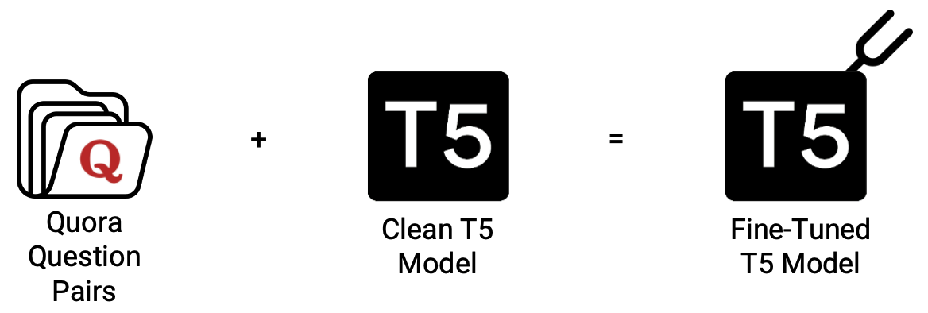
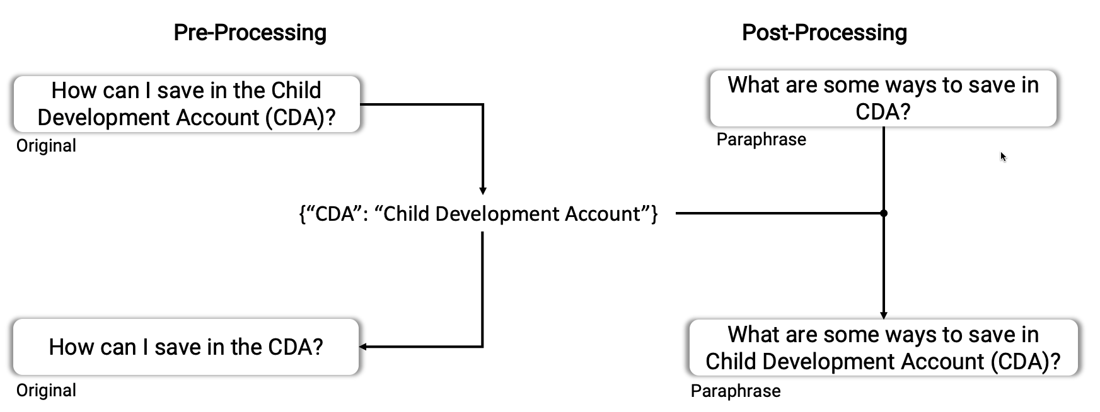
Conclusion
Fine-Tuned T5 Model
Conclusion
Notes:
All in all, we have tackled the task of data augmentation of FAQ datasets using pretrained language models such as T5 and SBERT model.
Firstly, we put in efforts into training the T5 model with the optimal hyperparameter values and the most suitable labelled paraphrase dataset Quora Question Pair. [CLICK] Secondly, the abbreviations handling in pre- and post-processing that I designed also helped us to retain domain terms within the paraphrases generated. [CLICK] Thirdly, we improved the candidate selection process with an additional step 2 that I designed to handle the observation where there are often similar FAQ pairs within the dataset. [CLICK] Lastly, we provided a command-line interface that users can perform the data augmentation of their FAQ dataset with the provision of a few input parameters.

Slide 26
Future Works
Improve the performance using new language models in the future e.g. GPT-3
Use Named Entity Recognition (NER) to retain domain-specific terms in a greater variety of formats such as organizational name and date
Perform Question Type Recognition to identify and ensure a greater diversity of grammatical structure among paraphrases
Gather actual user queries after deployment and use as in-domain dataset for fine-tuning the neural model
Future Works
Notes:
While we have done our best to design and implement this system with the limited resources we have, this project is by no means perfect and can be possibly improved in the future through these four ways. Firstly, we can improve the performance using new language models introduced in the future. An example is using the recently introduced GPT-3. Secondly, we can use Named Entity Recognition, in short NER, to retain domain-specific terms in a greater variety of formats such as organizational name and date. Thirdly, we can perform question type recognition in the candidate selection process to ensure that paraphrases retained have a wider variety of grammatical structure. Lastly, we can use actual user queries after deployment as an in-domain dataset for fine-tuning the neural model.

Slide 27
Acknowledgements
All icons used are sourced from https://www.flaticon.com/. All other images are sourced from Google.
Diagrams are created from these icons by using https://www.figma.com/.
FAQ questions are retrieved from MSF Baby Bonus FAQ webpage.
Paraphrases and their corresponding similarity scores are generated using the Paraphrase Generation System implemented in this Final Year Project, unless otherwise stated.
Thank you for the guidance and feedbacks from Assoc. Prof Chng Eng Siong and his team, including Damien Cheng, Thi Ly and Zin Tun throughout the FYP project.
Notes:
Thank you everyone for your time, and to assoc. prof Chng and his team for their guidance and feedbacks.

